Slide 1
Instagram User Analytics
Name- Samiksha Zagade

Slide 2
PROJECT DESCRIPTION
This project aims analyzing user interactions and engagement with the Instagram app to provide valuable insights that can help the business grow. In this project, I have used SQL and MySQL Workbench as a tool to analyze Instagram user data and answer questions posed by the management team. I have tried getting the answers to the questions raised. The insights derived from this analysis are used by various teams within the business. The questions and the insights are as follows.

Slide 3
TOOLS USED
The tools that I used to do this analysis is SQL(Structures Query Language) and the software used is MySQL Workbench. I chose to do this project in this software because of the ease by which we can handle and analyze the data here is very good. SQL is very helpful when we work on relational databases which was one of the reasons why I chose them for the project. SQL enables us to make insights on the past data.

Slide 4
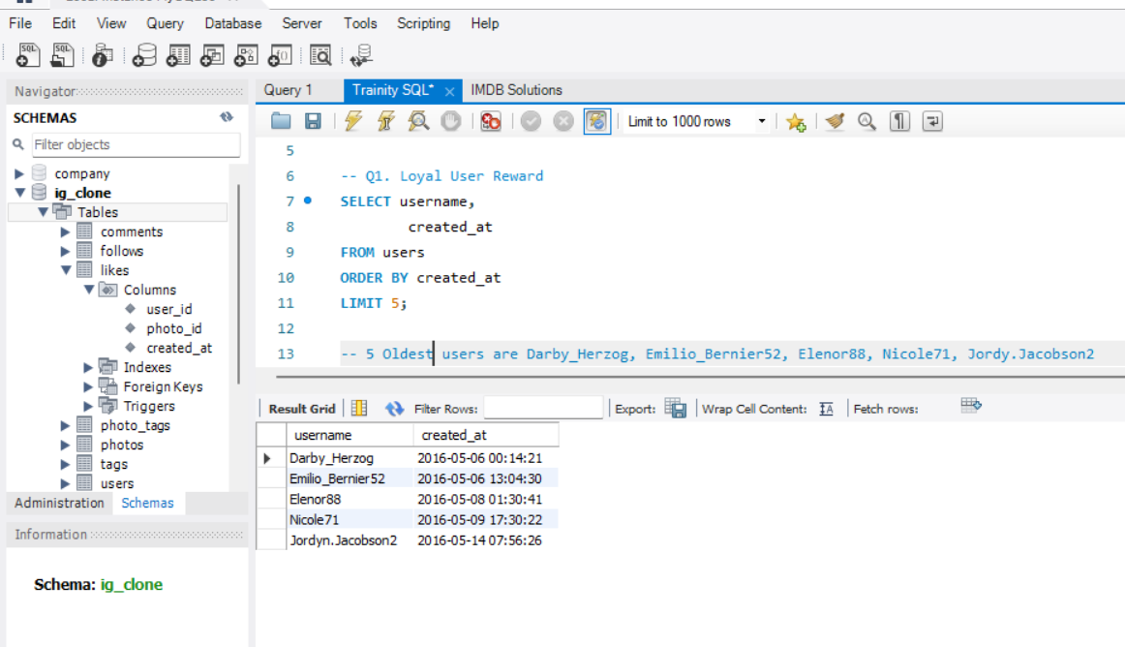
Loyal User Reward
The first step was understanding and reading the data.
Then I found the most loyal user of Instagram.
The 5 Oldest users are Darby_Herzog, Nicole71, Emilio_Bernier52, Elenor88 and Jordy.Jacobson2, they are the most loyal users of Instagram.

Slide 5
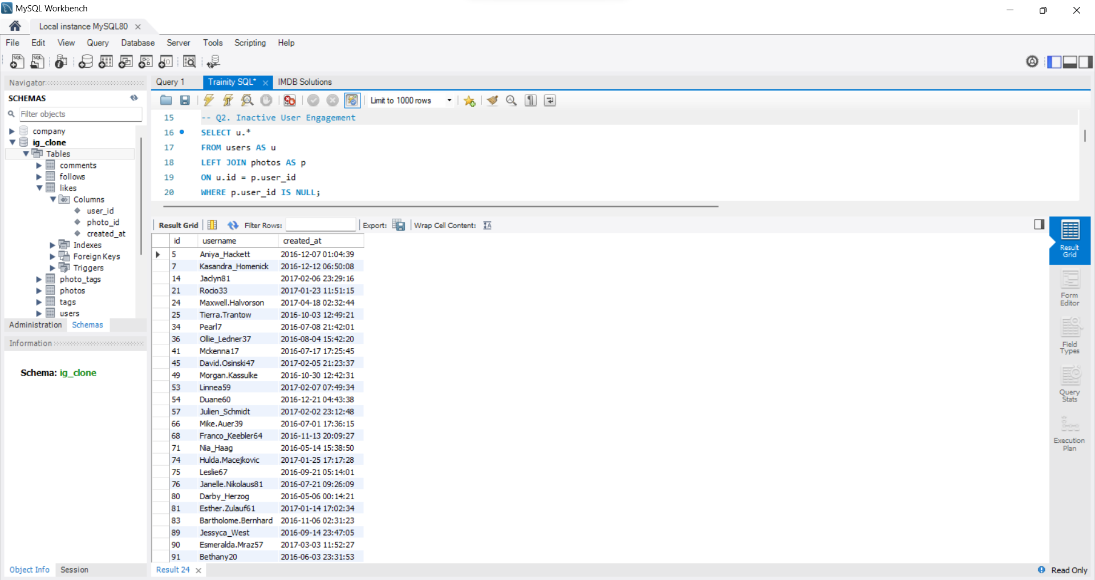
Inactive User Engagement
The next step was identifying the inactive users.
There are 26 inactive users.
The inactive users can be encouraged to use the application again by sending them ads and emails.
Instagram can target these users so that the users will become active again.

Slide 6
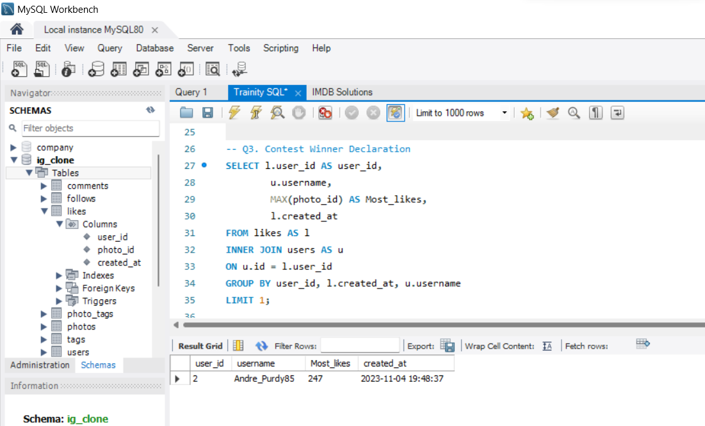
Contest Winner Declaration
Next we found a winner for a contest which Instagram had organized.
The team has organized a contest where the user with the most likes on a single photo wins.
Andre_Purdy85 was the username of the user who won this contest.
This contest will only increase the competition between users becoming more active on Instagram.

Slide 7
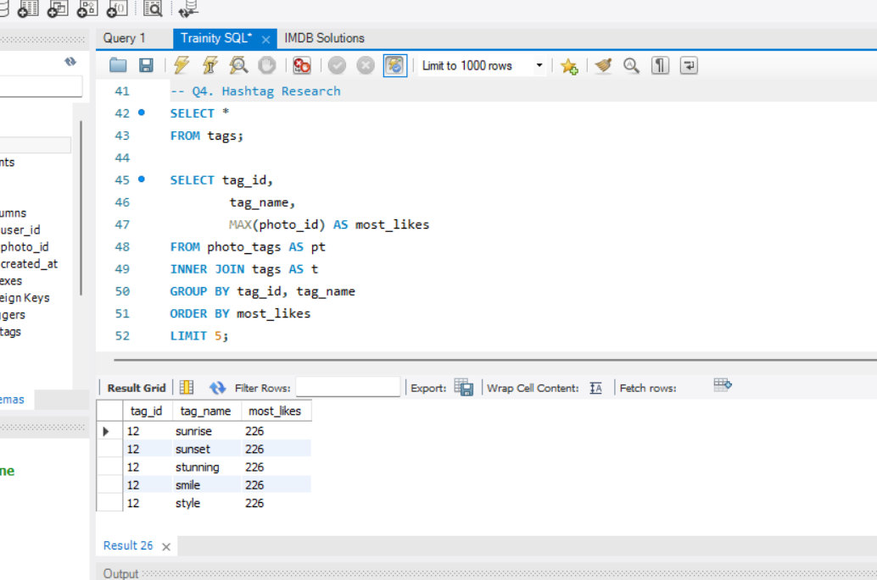
Hashtag Research
Next we found the most popular hashtags.
A partner brand wants to know the most popular hashtags to use in their posts to reach the most people.
The top five hashtags used were sunrise, sunset, stunning, smile and style.

Slide 8
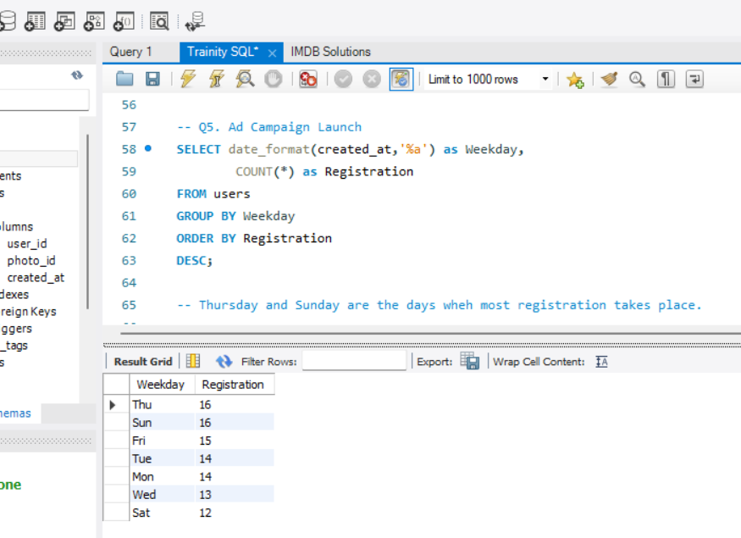
Ad Campaign Launch
Next I checked the day of the week when most of the users register.
The team wants to know the best day of the week to launch ads.
Thursday and Sunday are the days wheh most registration takes place.

Slide 9
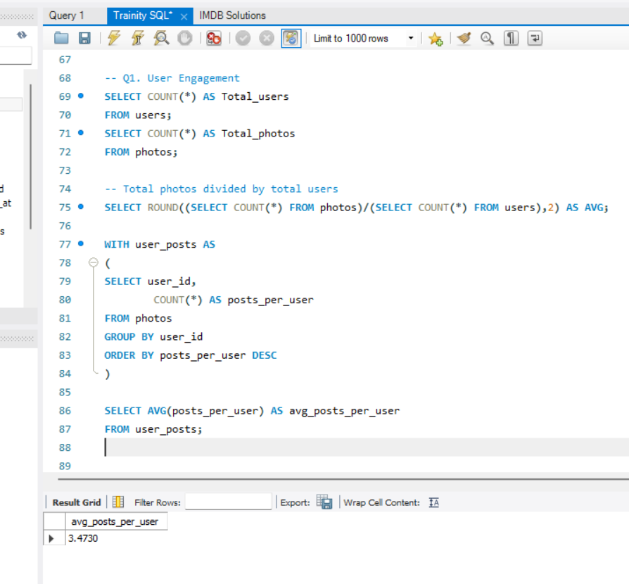
User Engagement
Investors want to know if users are still active and posting on Instagram or if they are making fewer posts.
By calculating the average number of posts per user we can see if users are still active or not.
The average number of posts per user is 3.4730.

Slide 10
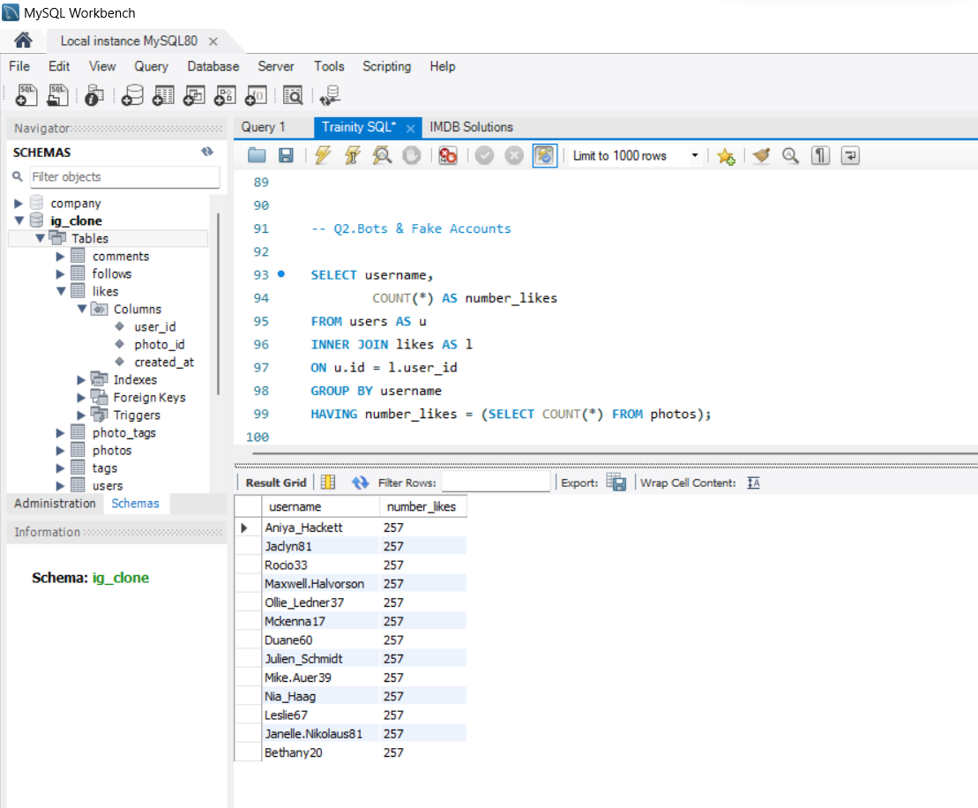
Bots & Fake Accounts
Investors want to know if the platform is crowded with fake and dummy accounts.
We checked the use who has liked every single post on instagram as it is not possible for normal users.
Hence we have found the fake accounts.
There are in total 13 such accounts registered.

Slide 11
INSIGHTS
After analyzing this data we were able to answer important questions which lead to valuable insights.
Even though there were many loyal users but we found considerable amount of users were inactive about 26 users were inactive.
Andre_Purdy85 username had the most likes and hence won the contest.
Five most hashtags used were sunrise, sunset, stunning, smile and style. Thus these hashtags will enable the post to reach maximum number of people as these are the most popular hashtags.
Thursday and Sunday are the days when most users register.
The average number of posts per user is 3.4730. The average tells if users are still active or not. Thus many users are still very active and their response is very good.
There are in total 13 such accounts registered which are fake or dummy accounts .

Slide 12
RESULTS
Thus the list of these inactive users will be encouraged to use Instagram by sending them emails.
Holding contest like this will not only motivate the winners to be more active but also increase the competitiveness of the users which will increase their activity on Instagram. Thus holding such contest will attract more potential users and inactive users too.
Using hashtags helps reach out to large crowd with ease and this helps with marketing and maximizes the view of the post.
Instagram team can launch new ads on these days. Every Thursday and Sunday new ads and contest can be posted which will attract many users.
The average number of posts per user tells if users are still active or not. Thus many users are still very active and their response is very good.
The fake accounts can either be restricted or blocked so that they do not cause inconvenience to other users.
Making the policies strict can also help in decreasing the number of fake or dummy accounts. These accounts can damage the application rating as the users will be inconvenienced by these accounts which something we want to avoid.
The project has helped in finding the Instagram team where they were lacking and how some changes they had made affected the progress which has been good for example holding contest, and engaging the inactive users.

Slide 13
THANK YOU

